Slide 1
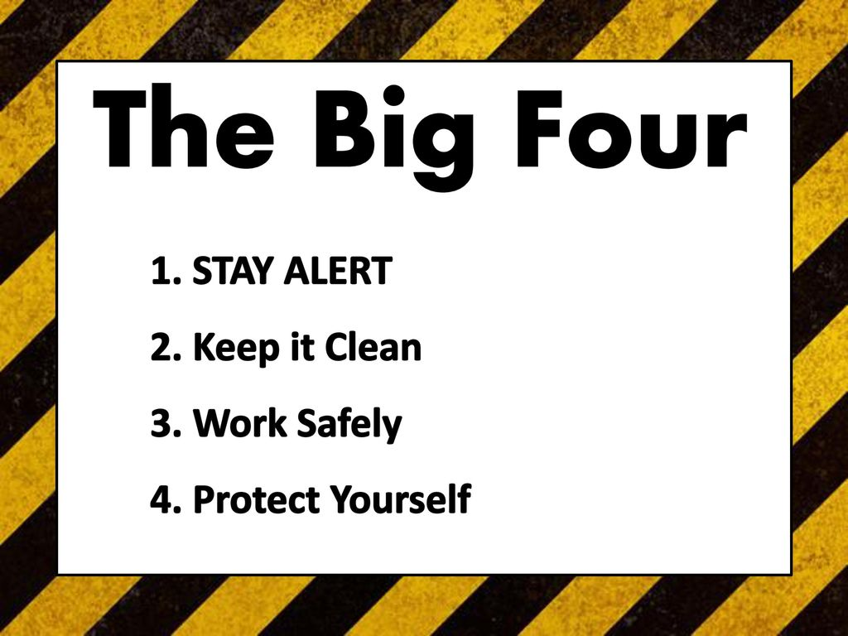
Learning Target: I can…
Identify all General Lab Safety rules to 100% accuracy.
Do Now: What does General Lab Safety look and sound like?
Instruction – General Lab Safety
General Lab Safety Certification Quiz
Check
Ticket out the door

Slide 2

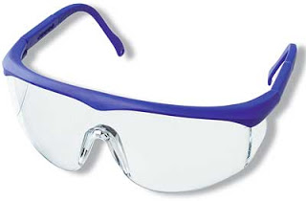
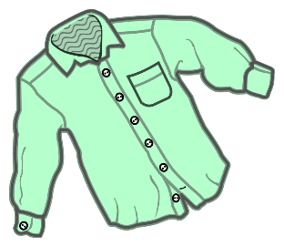
Learning Target: I can…
Identify all General Lab Safety rules to 100% accuracy.
You must immediately report all injuries, no matter how small, to your instructor.
You must wear approved eye protection at all times in the shop area.
Before entering the shop, you should always take safety steps such as: secure loose clothing, remove jewelry, roll up long sleeves, and tuck in or tie back long hair.

Slide 3



Learning Target: I can…
Identify all General Lab Safety rules to 100% accuracy.
The ‘Operator Zone’ or ‘Safety Zone’ around each machine refers to the area where the machine operator can stand.
Only One person is allowed in the Operator/ Safety Zone at one time.
When you see a damaged tool or other unsafe condition in the shop, inform the instructor immediately.

Slide 4



Learning Target: I can…
Identify all General Lab Safety rules to 100% accuracy.
Rags containing combustible chemicals (chemicals that can catch fire) must be disposed of in an approved covered metal container.
Before using any power equipment, you must obtain permission from your instructor.
If you have not passed a machine-specific safety test, or general lab safety test, with a score of 100%, you are not permitted to use that machine or work in the shop.

Slide 5

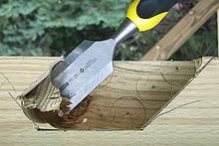
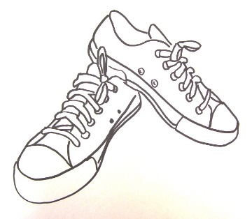
Learning Target: I can…
Identify all General Lab Safety rules to 100% accuracy.
If you notice any broken or damaged tools, instruments, or equipment, or you think a machine is not working properly, you should not use it and notify your instructor right away.
When using a sharp hand tool (like a chisel) you should cut away from your body and hands.
Open-toed shoes, (sandals, flip flops, etc.) are not acceptable to wear in the shop.

Slide 6



Learning Target: I can…
Identify all General Lab Safety rules to 100% accuracy.
Safety guards on machines are for your protection – never use a machine without a safety guard.
Only the operator of a machine is allowed to turn on or off the machine.
If you see items that might cause someone to slip and fall, you should place the items in a safer place or ask your instructor for help.

Slide 7



Learning Target: I can…
Identify all General Lab Safety rules to 100% accuracy.
‘Horseplay’ in the classroom, lab, or shop is disruptive to learning, could cause an accident, and is forbidden at all times in the shop.
All projects and activities must be approved by the instructor before beginning work on them.
If you are not sure how to operate a machine or hand tool, you should ask the instructor to review it with you.

Slide 8

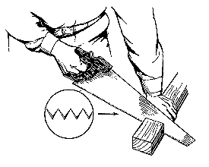

Learning Target: I can…
Identify all General Lab Safety rules to 100% accuracy.
Unnecessary movements or noise caused by students during lab time could easily distract a machine operator and cause an accident.
Sharp tools are safer to use than dull tools.
Do not walk away from a machine while it is still on, or still coasting to a stop.

Slide 9



Learning Target: I can…
Identify all General Lab Safety rules to 100% accuracy.
Do not talk to the teacher or another student while they are operating a machine.
Always use a bench brush to clean debris and scraps from a table or machine.
In case of an emergency immediately turn off your machine and follow the teacher’s instructions.

Slide 10


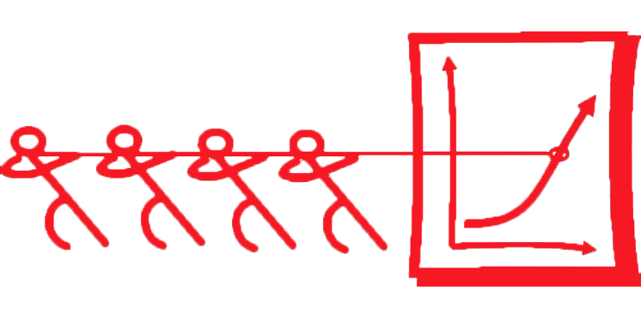
Learning Target: I can…
Identify all General Lab Safety rules to 100% accuracy.
You should not use compressed air to clean off your hair, your clothing, or skin.
Students should use a vice or clamps to secure small projects that are too difficult or dangerous to hold by hand.
Use two, or more, people if necessary to safely handle, or move large, long, or heavy materials.

Slide 11


Learning Target: I can…
Identify all General Lab Safety rules to 100% accuracy.
It is VERY necessary to wear safety glasses around compressed air, air hoses, and air nozzles – it could be very dangerous to your eyes.
Questions?
Prepare for your General Lab Safety Quiz.

Slide 12

Learning Target: I can…
Identify all General Lab Safety rules to 100% accuracy.
Ticket out the door:
What are 3 ways to be safe in the shop?

